Slide 1
AGE-FRIENDLY WAIMAKARIRI
Looking to the Future

Slide 2
TODAY -The Age-friendly Advisory Group wants to:
Acknowledge and thank the Waimakariri District Council for their support over the last 3 years.
Record the contribution of our Facilitator Madeleine Burdon.
Extend our appreciation for the contribution of Councillor Wendy Doody

Slide 3
TODAY –We also want:
Approval to continue working with the Council on Age-friendly matters.
Approval for some changes and refinements in our role and work programme to make the Advisory Group more effective.

Slide 4
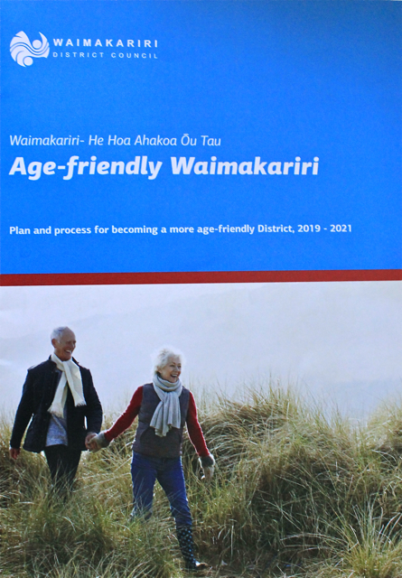
The current plan

Slide 5
Principles to underpin the future work of the Age-friendly Advisory Group: 1. Establishing trust through partnerships to ensure hierarchies are accountable. 2. Ensuring power “sticks to neighbourhoods”. 3. Strengthening community infrastructure and opportunities. 4 Accessing levers and resources to take action locally. From key principles of “Localism” from a Local Government NZ “Think Tank” paper 2021

Slide 6
THE AGE-FRIENDLY ADVISORY GROUP HAS IDENTIFIED THESE ROLES FOR THE FUTURE: 1. Advising on Planning 2. Monitoring 3. Supporting/Endorsing 4. Advocacy/Accountability 5. Networking:

Slide 7
The Age-friendly Advisory Group seeks: Endorsement of revised Terms of Reference. Awareness that the Age-friendly Advisory Group will initiate ongoing consultation with older people and the organisations that work with them to inform future planning. Support for the mahi with WDC staff to ensure delivery of Age-friendly outcomes.

Slide 8
RECOMMENDATIONS: It is recommended that the Community and Recreation Committee of the Waimakariri District Council: Notes this presentation. Agrees with the outcomes from the Waimakariri Age-friendly Advisory Group review. Approves the changes to the Terms of Reference for the Advisory Group – to be tabled with the Facilitator’s Report. Endorses the example “Work Programme” for progressing and guiding future planning.

